Slide 1
Lecture 3, Sections 1-2
Computational Chemistry

Slide 2
Lecture 3 Contents
The Many Electron Problem
The Hartree Model
Pauli Principle
Slater Determinants
Hartree-Fock Model
Hartree-Fock-Slater Model
Numerical Methods for Implementation

Slide 3
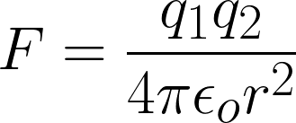
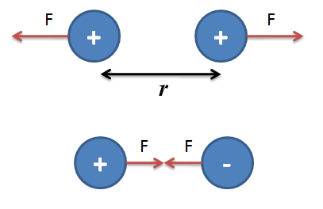
Electron Repulsion
Electron-electron interactions occur within atoms other than Hydrogen.
Coulomb’s Law:
Where:
q1, q2 = Particle charge
є_{o} = Vacuum Permittivity
r = Distance between particle centers
This force contributes to the potential energy of an n-electron atom when n > 1.

Slide 4



n-Electron Atom Schrödinger Equation
For an n-electron system: Differences from the Hydrogen case:
Function of 3*n coordinate variables
Unsolvable with analytical methods even for n=2!
The Schrödinger equation generalized:

Slide 5

Approximate Solution to n-Electron Problem
The Hartree Model is an approximation for the many body Schrödinger equation.
Assumptions:
Mean-field model
Born-Oppenheimer approximation
Method:
For non-correlated electrons, the wavefunction can be written as a Hartree Product. The product can be either spatial or spin orbitals.

Slide 6


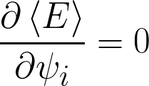
Hartree Model Methods (1/2)
Variational Principle:
With Hartree Product:
The most natural Hartree Product minimizes the energy expectation value.

Slide 7



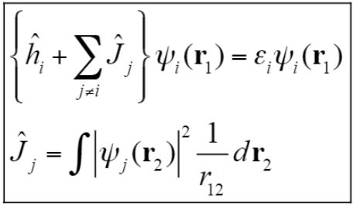

Hartree Model Methods (2/2)
Lagrange Multipliers:
Constrain our spatial orbitals to be orthonormal:
Minimize the energy expectation value within the constraint:
n-single electron Hartree Problems.
J is the operator for average repulsion between electrons j and i.

Slide 8

Hartree Model Methods (2/2)
Lagrange Multipliers:
To solve for energies, use separation of variables to separate the radial and spherical components of an orbital.
Can analytically solve to get the orbital and energy for each electron in the atom.
How do we know what function to use for the orbital?

Slide 9
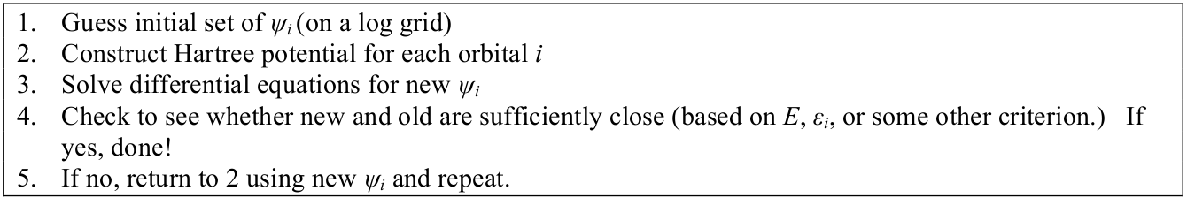
Hartree Model Methods (2/2)
Self-Consistent Field Method to find Orbitals
Hartree’s own numerical method for finding orbital expressions.
For each orbital iteration, the boundary conditions must be satisfied. Gaussian or Slater-type orbital functions are typically guessed.

Slide 10
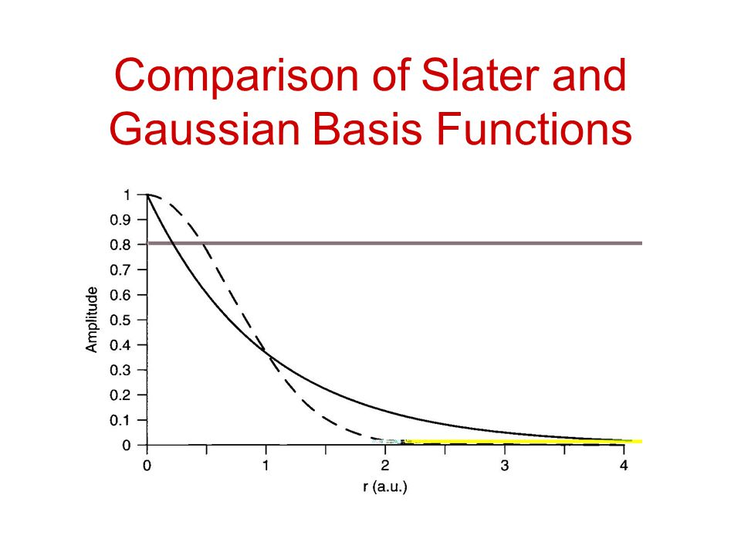


Gaussian vs. Slater Functions
Slater-type Orbital
Gaussian-type Orbital

